Slide 2
Hebrews 4:12 For the word of God is alive and active. Sharper than any double-edged sword, it penetrates even to dividing soul and spirit, joints and marrow; it judges the thoughts and attitudes of the heart.

Slide 3
“Flee Babylon and live Holy”

Slide 4
Haggai 2:11-14 “This is what the Lord Almighty says: ‘Ask the priests what the law says: ¹² If someone carries consecrated meat in the fold of their garment, and that fold touches some bread or stew, some wine, olive oil or other food, does it become consecrated?’” The priests answered, “No.”¹³ Then Haggai said, “If a person defiled by contact with a dead body touches one of these things, does it become defiled?” “Yes,” the priests replied, “it becomes defiled.”¹⁴ Then Haggai said, “‘So it is with this people and this nation in my sight,’ declares the Lord. ‘Whatever they do and whatever they offer there is defiled.
John 6:14-15

Slide 5
Haggai 2:11-14 (The Living Bible) Ask the priests this question about the law: "If one of you is carrying a holy sacrifice in his robes, and happens to brush against some bread or wine or meat, will it too become holy?" "No," the priests replied. "Holiness does not pass to other things that way." Then Haggai asked, "But if someone touches a dead person, and so becomes ceremonially impure, and then brushes against something, does it become contaminated?" And the priests answered, "Yes." Haggai then made his meaning clear. "You people," he said (speaking for the Lord), "were contaminating your sacrifices by living with selfish attitudes and evil hearts—and not only your sacrifices, but everything else that you did as a 'service' to me."

Slide 6
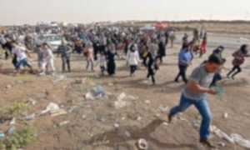
Jeremiah 51:6 “Flee from Babylon! Run for your lives! Do not be destroyed because of her sins. It is time for the Lord’s vengeance; he will repay her what she deserves.

Slide 7
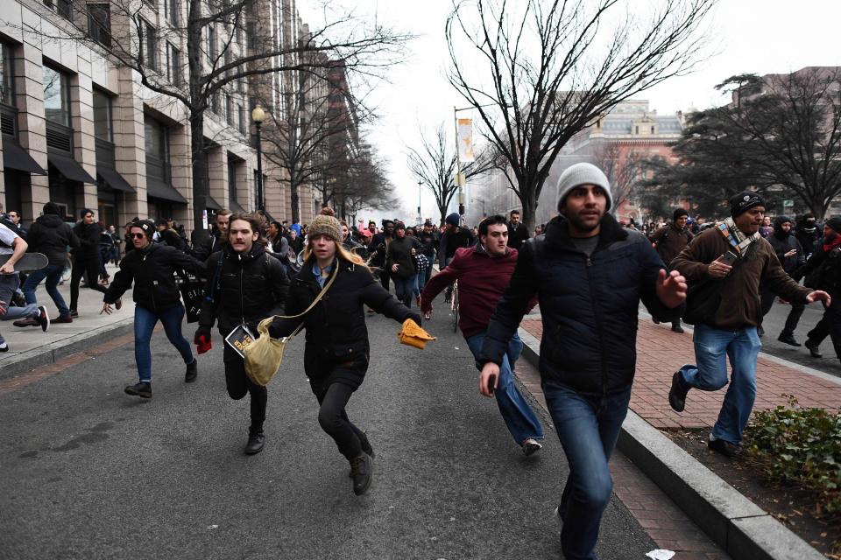
Acts 6:7 So the word of God spread. The number of disciples in Jerusalem increased rapidly, and a large number of priests became obedient to the faith.
Acts 12:24 But the word of God continued to spread and flourish.
Acts 16:5 So the churches were strengthened in the faith and grew daily in number
Acts 19:20 In this way the word of the Lord spread widely and grew in power.
Exodus 3:14
Jeremiah 51:45 “Come out of her, my people! Run for your lives Run from the fierce anger of the Lord.

Slide 8
Romans 8:7-8
The mind governed by the flesh is hostile to God; it does not submit to God’s law, nor can it do so. ⁸ Those who are in the realm of the flesh cannot please God.

Slide 9
1 Thessalonians 4:7-8
For God did not call us to be impure, but to live a holy life. ⁸ Therefore, anyone who rejects this instruction does not reject a human being but God, the very God who gives you his Holy Spirit.

Slide 10
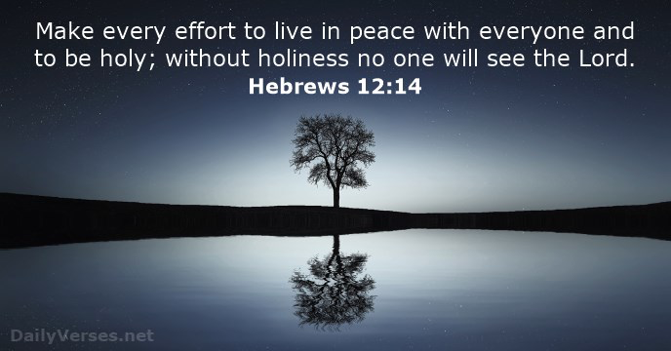

Slide 11
1 Peter 1:15-16 But just as he who called you is holy, so be holy in all you do; ¹⁶ for it is written: “Be holy, because I am holy.”

Slide 12
Jeremiah 50:6-8 “My people have been lost sheep; their shepherds have led them astray and caused them to roam on the mountains. They wandered over mountain and hill and forgot their own resting place. ⁷ Whoever found them devoured them their enemies said, ‘We are not guilty, for they sinned against the Lord, their verdant pasture, the Lord, the hope of their ancestors.’ ⁸ “Flee out of Babylon; leave the land of the Babylonians, and be like the goats that lead the flock.

Slide 13
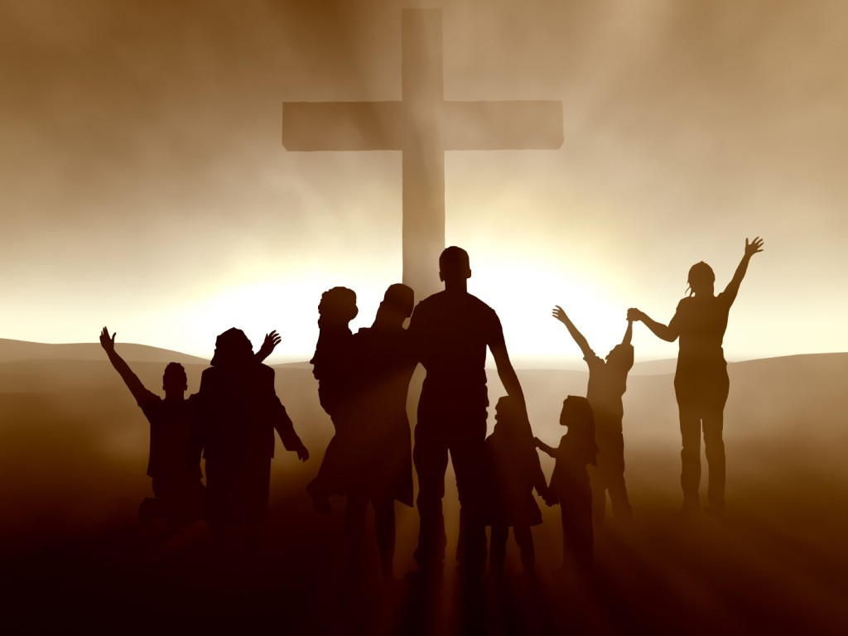
But you are a chosen people, a royal priesthood, a holy nation, God’s special possession, that you may declare the praises of him who called you out of darkness into his wonderful light - 1 Peter 2:9

Slide 14
Isaiah 42:6-8 “I, the Lord, have called you in righteousness; I will take hold of your hand. I will keep you and will make you to be a covenant for the people and a light for the Gentiles, to open eyes that are blind, to free captives from prison and to release from the dungeon those who sit in darkness. “I am the Lord; that is my name! I will not yield my glory to another or my praise to idols.

