Slide 2
“Fear Not, Little Flock ”
“ it is your Father’s good pleasure to give you the kingdom.”

Slide 3
Hebrews 4:12 For the word of God is alive and active. Sharper than any double-edged sword, it penetrates even to dividing soul and spirit, joints and marrow; it judges the thoughts and attitudes of the heart.

Slide 4
Matthew 10:1-8 Jesus called his twelve disciples to him and gave them authority to drive out impure spirits and to heal every disease and sickness.² These are the names of the twelve apostles: first, Simon (who is called Peter) and his brother Andrew; James son of Zebedee, and his brother John; ³ Philip and Bartholomew; Thomas and Matthew the tax collector; James son of Alphaeus, and Thaddaeus; ⁴ Simon the Zealot and Judas Iscariot, who betrayed him. ⁵ These twelve Jesus sent out with the following instructions: “Do not go among the Gentiles or enter any town of the Samaritans. ⁶ Go rather to the lost sheep of Israel. ⁷ As you go, proclaim this message: ‘The kingdom of heaven has come near.’ ⁸ Heal the sick, raise the dead, cleanse those who have leprosy, drive out demons. Freely you have received; freely give.
John 6:14-15

Slide 5
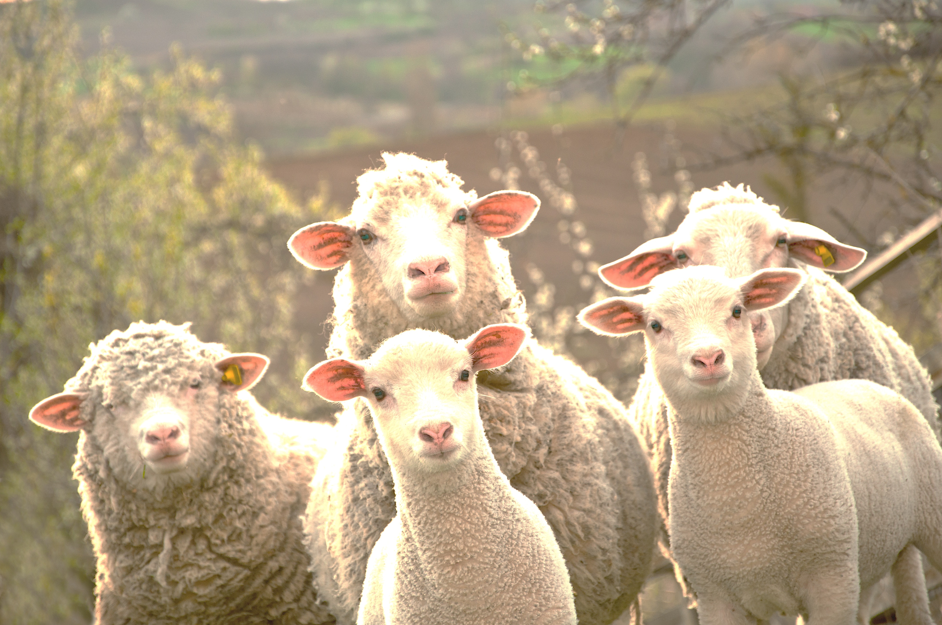
Luke 12:33-34 “Do not be afraid, little flock, for your Father has been pleased to give you the kingdom. ³³ Sell your possessions and give to the poor. Provide purses for yourselves that will not wear out, a treasure in heaven that will never fail, where no thief comes near and no moth destroys. ³⁴ For where your treasure is, there your heart will be also.

Slide 6
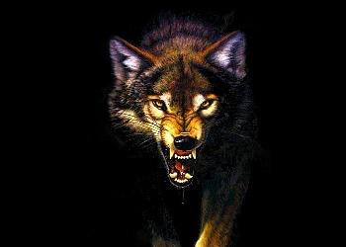
Matthew 10:16-20 “I am sending you out like sheep among wolves. Therefore be as shrewd as snakes and as innocent as doves.¹⁷Be on your guard; you will be handed over to the local councils and be flogged in the synagogues. ¹⁸On my account you will be brought before governors and kings as witnesses to them and to the Gentiles.¹⁹But when they arrest you, do not worry about what to say or how to say it. At that time you will be given what to say, ²⁰ for it will not be you speaking, but the Spirit of your Father speaking through you.

Slide 7
Romans 6:1-4 What shall we say, then? Shall we go on sinning so that grace may increase? ² By no means! We are those who have died to sin; how can we live in it any longer? ³ Or don’t you know that all of us who were baptized into Christ Jesus were baptized into his death? ⁴ We were therefore buried with him through baptism into death in order that, just as Christ was raised from the dead through the glory of the Father, we too may live a new life.

Slide 8
Acts 6:7 So the word of God spread. The number of disciples in Jerusalem increased rapidly, and a large number of priests became obedient to the faith.
Acts 12:24 But the word of God continued to spread and flourish.
Acts 16:5 So the churches were strengthened in the faith and grew daily in number
Acts 19:20 In this way the word of the Lord spread widely and grew in power.
Romans 6:11-13
In the same way, count yourselves dead to sin but alive to God in Christ Jesus. ¹² Therefore do not let sin reign in your mortal body so that you obey its evil desires. ¹³ Do not offer any part of yourself to sin as an instrument of wickedness, but rather offer yourselves to God as those who have been brought from death to life; and offer every part of your self to him as an instrument of righteousness
Exodus 3:14

Slide 9
Romans 6:21-23 What benefit did you reap at that time from the things you are now ashamed of? Those things result in death! ²² But now that you have been set free from sin and have become slaves of God, the benefit you reap leads to holiness, and the result is eternal life. ²³ For the wages of sin is death, but the gift of God is eternal life in Christ Jesus our Lord.

Slide 10
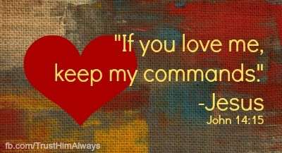

Slide 11
2 Corinthians 5:17 Therefore, if anyone is in Christ, the new creation has come: The old has gone, the new is here!

Slide 12
1 Corinthians 1:30
It is because of him that you are in Christ Jesus, who has become for us wisdom from God that is, our righteousness, holiness and redemption

Slide 13
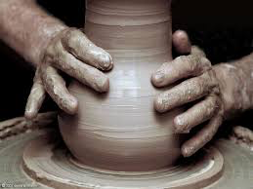
Ephesians 2:10 For we are God’s handiwork, created in Christ Jesus to do good works, which God prepared in advance for us to

Slide 14
John 15:5 “I am the vine; you are the branches. If you remain in me and I in you, you will bear much fruit; apart from me you can do nothing.

Slide 15
Titus 3:4-5
But when the kindness and love of God our Savior appeared, ⁵ he saved us, not because of righteous things we had done, but because of his mercy. He saved us through the washing of rebirth and renewal by the Holy Spirit,

Slide 16
Colossians 3:2-4 Set your minds on things above, not on earthly things. ³ For you died, and your life is now hidden with Christ in God.⁴ When Christ, who is your life, appears, then you also will appear with him in glory.

