Slide 2
“Drowsy Disciples – Slumbering Servants”

Slide 3
Hebrews 4:12 For the word of God is alive and active. Sharper than any double-edged sword, it penetrates even to dividing soul and spirit, joints and marrow; it judges the thoughts and attitudes of the heart.

Slide 4
Mark 14:32-34
They went to a place called Gethsemane, and Jesus said to his disciples, “Sit here while I pray.” ³³ He took Peter, James and John along with him, and he began to be deeply distressed and troubled. ³⁴ “My soul is overwhelmed with sorrow to the point of death,” he said to them. “Stay here and keep watch.”
John 6:14-15

Slide 5
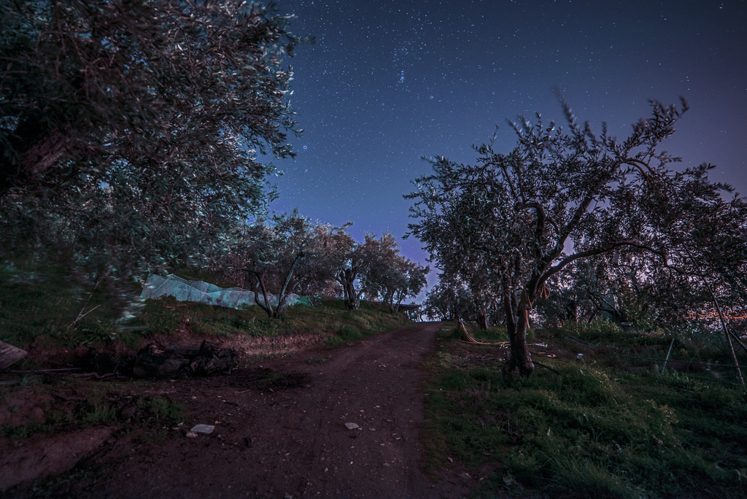
Luke 22:39
Jesus went out as usual to the Mount of Olives, and his disciples followed him.

Slide 6
Mark 14:35 -36
Going a little farther, he fell to the ground and prayed that if possible the hour might pass from him. ³⁶ “Abba, Father,” he said, “everything is possible for you. Take this cup from me. Yet not what I will, but what you will.”

Slide 7
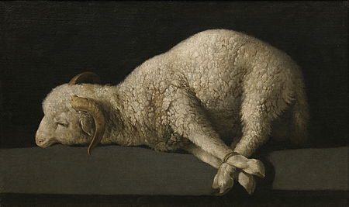
John 1:29
The next day John saw Jesus coming toward him and said, “Look, the Lamb of God, who takes away the sin of the world!

Slide 9
Mark 14:37-38
Then he returned to his disciples and found them sleeping. “Simon,” he said to Peter, “are you asleep? Couldn’t you keep watch for one hour?³⁸ Watch and pray so that you will not fall into temptation. The spirit is willing, but the flesh is weak.”
Exodus 3:14

Slide 10
.

Slide 11
Mark 14:39-41
Once more he went away and prayed the same thing. ⁴⁰ When he came back, he again found them sleeping, because their eyes were heavy. They did not know what to say to him.⁴¹ Returning the third time, he said to them, “Are you still sleeping and resting? Enough! The hour has come. Look, the Son of Man is delivered into the hands of sinners.

Slide 12
Hebrews 5:7
During the days of Jesus’ life on earth, he offered up prayers and petitions with fervent cries and tears to the one who could save him from death, and he was heard because of his reverent submission.

Slide 13
Revelation 14:10 they, too, will drink the wine of God’s fury, which has been poured full strength into the cup of his wrath. They will be tormented with burning sulfur in the presence of the holy angels and of the Lamb.
Revelation 19:15 Coming out of his mouth is a sharp sword with which to strike down the nations. “He will rule them with an iron scepter.” He treads the winepress of the fury of the wrath of God Almighty.

Slide 14
Matthew 25:1-13 “At that time the kingdom of heaven will be like ten virgins who took their lamps and went out to meet the bridegroom. ² Five of them were foolish and five were wise. ³ The foolish ones took their lamps but did not take any oil with them. ⁴ The wise ones, however, took oil in jars along with their lamps.⁵ The bridegroom was a long time in coming, and they all became drowsy and fell asleep. ⁶ “At midnight the cry rang out: ‘Here’s the bridegroom! Come out to meet him!’ ⁷ “Then all the virgins woke up and trimmed their lamps. ⁸ The foolish ones said to the wise, ‘Give us some of your oil; our lamps are going out.’ ⁹ “‘No,’ they replied, ‘there may not be enough for both us and you. Instead, go to those who sell oil and buy some for yourselves.’¹⁰ “But while they were on their way to buy the oil, the bridegroom arrived. The virgins who were ready went in with him to the wedding banquet. And the door was shut. ¹¹ “Later the others also came. ‘Lord, Lord,’ they said, ‘open the door for us!’ ¹² “But he replied, ‘Truly I tell you, I don’t know you.’ ¹³ “Therefore keep watch, because you do not know the day or the hour.

Slide 15
Luke 21:34-38
“Be careful, or your hearts will be weighed down with carousing, drunkenness and the anxieties of life, and that day will close on you suddenly like a trap. ³⁵ For it will come on all those who live on the face of the whole earth. ³⁶ Be always on the watch, and pray that you may be able to escape all that is about to happen, and that you may be able to stand before the Son of Man.”³⁷ Each day Jesus was teaching at the temple, and each evening he went out to spend the night on the hill called the Mount of Olives, ³⁸ and all the people came early in the morning to hear him at the temple.

Slide 16
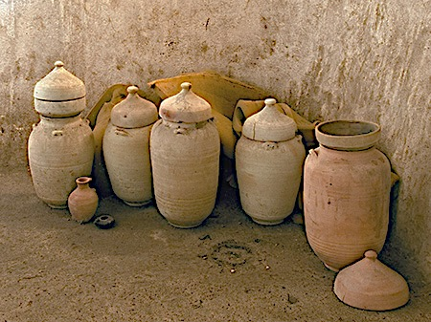
2 Timothy 2:20-21 Now in a great house there are not only vessels of gold and silver but also of wood and clay, some for honorable use, some for dishonorable. ²¹ Therefore, if anyone cleanses himself from what is dishonorable, he will be a vessel for honorable use, set apart as holy, useful to the master of the house, ready for every good work.

Slide 17
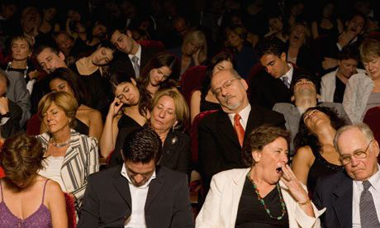
Romans 13:11-12
And do this, knowing the time, that now it is high time to awake out of sleep; for now our salvation is nearer than when we first believed. The night is far spent, the day is at hand. Therefore let us cast off the works of darkness, and let us put on the armor of light.

