Slide 2
“Dressed, Ready and Watching”

Slide 3
Hebrews 4:12 For the word of God is alive and active. Sharper than any double-edged sword, it penetrates even to dividing soul and spirit, joints and marrow; it judges the thoughts and attitudes of the heart.

Slide 4
Luke 12:35-36 “Be dressed ready for service and keep your lamps burning, ³⁶ like servants waiting for their master to return from a wedding banquet, so that when he comes and knocks they can immediately open the door for him.
John 6:14-15

Slide 5
Exodus 12:11 This is how you are to eat it: with your cloak tucked into your belt, your sandals on your feet and your staff in your hand. Eat it in haste; it is the Lord’s Passover.

Slide 6
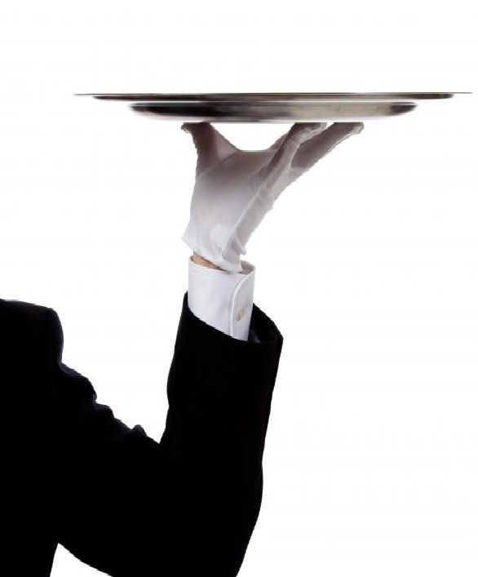
Luke 12:37-38 It will be good for those servants whose master finds them watching when he comes. Truly I tell you, he will dress himself to serve, will have them recline at the table and will come and wait on them. ³⁸ It will be good for those servants whose master finds them ready, even if he comes in the middle of the night or toward daybreak.

Slide 7
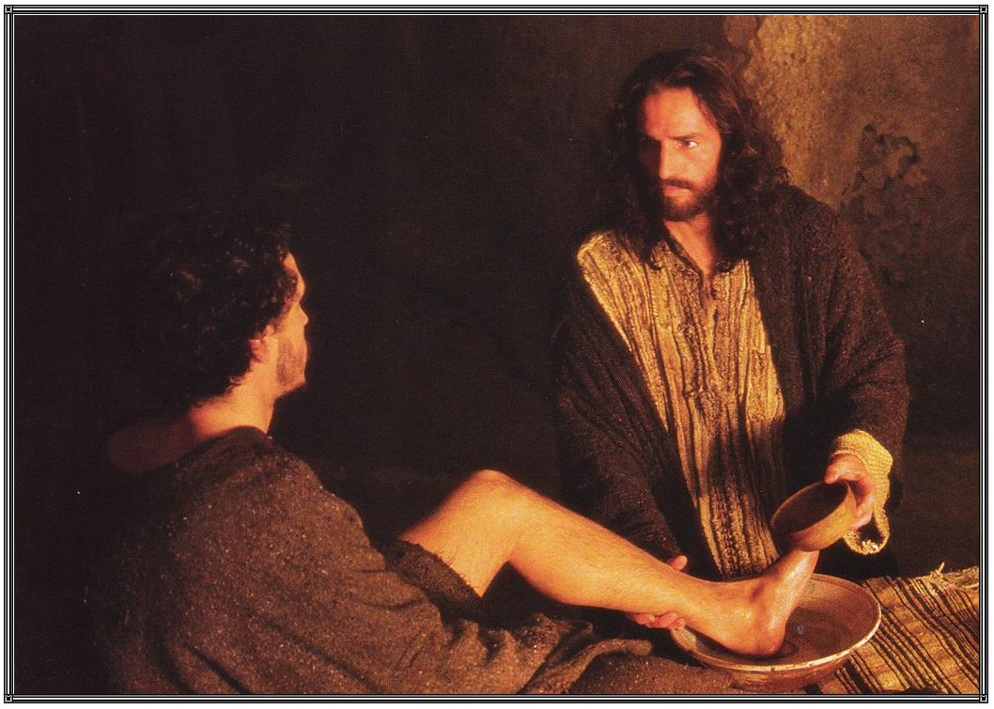
John13:12-14 When he had finished washing their feet, he put on his clothes and returned to his place. “Do you understand what I have done for you?” he asked them. ¹³ “You call me ‘Teacher’ and ‘Lord,’ and rightly so, for that is what I am. ¹⁴ Now that I, your Lord and Teacher, have washed your feet, you also should wash one another’s feet.

Slide 8
Luke 12:39-40
But understand this: If the owner of the house had known at what hour the thief was coming, he would not have let his house be broken into. ⁴⁰ You also must be ready, because the Son of Man will come at an hour when you do not expect him.

Slide 9
Isaiah 2:11 The eyes of the arrogant will be humbled and human pride brought low; the Lord alone will be exalted in that day.

Slide 10
Luke 12:41
Peter asked, “Lord, are you telling this parable to us, or to everyone?”
Exodus 3:14

Slide 11
Mark 13:37
What I say to you, I say to everyone: “Watch!”
.

Slide 12
Luke 12:42-44
The Lord answered, “Who then is the faithful and wise manager, whom the master puts in charge of his servants to give them their food allowance at the proper time? ⁴³ It will be good for that servant whom the master finds doing so when he returns. ⁴⁴ Truly I tell you, he will put him in charge of all his possessions.

Slide 13
Luke 12:45-46 But suppose the servant says to himself, ‘My master is taking a long time in coming,’ and he then begins to beat the other servants, both men and women, and to eat and drink and get drunk. ⁴⁶ The master of that servant will come on a day when he does not expect him and at an hour he is not aware of. He will cut him to pieces and assign him a place with the unbelievers.

Slide 14
Mark 13:5
Jesus said to them: “Watch out that no one deceives you.

Slide 15
Luke 12:47-48
“The servant who knows the master’s will and does not get ready or does not do what the master wants will be beaten with many blows. ⁴⁸ But the one who does not know and does things deserving punishment will be beaten with few blows. From everyone who has been given much, much will be demanded; and from the one who has been entrusted with much, much more will be asked.

Slide 16
2 Peter 2:20-21 If they have escaped the corruption of the world by knowing our Lord and Savior Jesus Christ and are again entangled in it and are overcome, they are worse off at the end than they were at the beginning. ²¹ It would have been better for them not to have known the way of righteousness, than to have known it and then to turn their backs on the sacred command that was passed on to them.

Slide 17
1 Thessalonians 4:16-18
For the Lord himself will come down from heaven, with a loud command, with the voice of the archangel and with the trumpet call of God, and the dead in Christ will rise first. ¹⁷ After that, we who are still alive and are left will be caught up together with them in the clouds to meet the Lord in the air. And so we will be with the Lord forever. ¹⁸ Therefore encourage one another with these words.

Slide 18
1 Thessalonians 5:4-8
But you, brothers and sisters, are not in darkness so that this day should surprise you like a thief. ⁵ You are all children of the light and children of the day. We do not belong to the night or to the darkness. ⁶ So then, let us not be like others, who are asleep, but let us be awake and sober. ⁷ For those who sleep, sleep at night, and those who get drunk, get drunk at night. ⁸ But since we belong to the day, let us be sober, putting on faith and love as a breastplate, and the hope of salvation as a helmet.

