Slide 2
The CALL
Come/Abide/Learn/Live

Slide 3
Hebrews 4:12
For the word of God is alive and active. Sharper than any double-edged sword, it penetrates even to dividing soul and spirit, joints and marrow; it judges the thoughts and attitudes of the heart.
Hebrews 4:12 For the word of God is alive and active. Sharper than any double-edged sword, it penetrates even to dividing soul and spirit, joints and marrow; it judges the thoughts and attitudes of the heart.

Slide 4
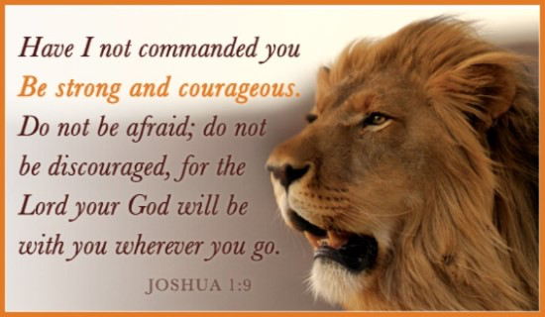
John 6:14-15

Slide 5
ABIDE :
1. To stay; to continue in a place; to have one's abode; to dwell;
2. To wait; to pause; to delay.
3. To remain stable or fixed in some state or condition; to continue; to remain.
4. To wait for; to be prepared for; to await; to watch for;

Slide 6
John 15:1- 4 “I am the true vine, and My Father is the vinedresser. ² Every branch in Me that does not bear fruit He takes away; and every branch that bears fruit He prunes, that it may bear more fruit. ³ You are already clean because of the word which I have spoken to you. ⁴ Abide in Me, and I in you. As the branch cannot bear fruit of itself, unless it abides in the vine, neither can you, unless you abide in Me.

Slide 7
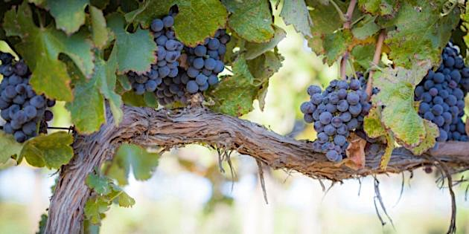
John 15:5
“I am the vine, you are the branches. He who abides in Me, and I in him, bears much fruit; for without Me you can do nothing.

Slide 8
John 15:6
If anyone does not abide in Me, he is cast out as a branch and is withered; and they gather them and throw them into the fire, and they are burned.

Slide 9
Hebrews 6:4-8 It is impossible for those who have once been enlightened, who have tasted the heavenly gift, who have shared in the Holy Spirit, ⁵ who have tasted the goodness of the word of God and the powers of the coming age ⁶ and who have fallen away, to be brought back to repentance. To their loss they are crucifying the Son of God all over again and subjecting him to public disgrace. ⁷ Land that drinks in the rain often falling on it and that produces a crop useful to those for whom it is farmed receives the blessing of God. ⁸ But land that produces thorns and thistles is worthless and is in danger of being cursed. In the end it will be burned.
Exodus 3:14

Slide 11
John 10:27-29
My sheep listen to my voice; I know them, and they follow me. ²⁸ I give them eternal life, and they shall never perish; no one will snatch them out of my hand. ²⁹ My Father, who has given them to me, is greater than all; no one can snatch them out of my Father’s hand.

Slide 12
John 15:7- 8
If you abide in Me, and My words abide in you, you will ask what you desire, and it shall be done for you. ⁸ By this My Father is glorified, that you bear much fruit; so you will be My disciples.

Slide 13
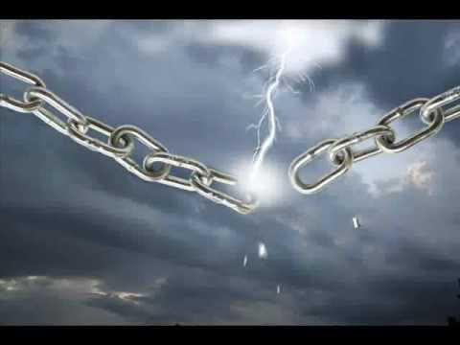
John 8:31-32
To the Jews who had believed him, Jesus said, “If you hold to my teaching, you are really my disciples. ³² Then you will know the truth, and the truth will set you free.”

Slide 14
John 15:9-14
“As the Father loved Me, I also have loved you; abide in My love. ¹⁰ If you keep My commandments, you will abide in My love, just as I have kept My Father’s commandments and abide in His love.¹¹ “These things I have spoken to you, that My joy may remain in you, and that your joy may be full. ¹² This is My commandment, that you love one another as I have loved you. ¹³ Greater love has no one than this, than to lay down one’s life for his friends. ¹⁴ You are My friends if you do whatever I command you.

