Slide 2
“A Holy Amputation”

Slide 3
Matthew 5:29-30 If your right eye causes you to stumble, gouge it out and throw it away. It is better for you to lose one part of your body than for your whole body to be thrown into hell. ³⁰ And if your right hand causes you to stumble, cut it off and throw it away. It is better for you to lose one part of your body than for your whole body to go into hell.
John 6:14-15

Slide 5
Hebrews 13:20-21 Now may the God of peace, who through the blood of the eternal covenant brought back from the dead our Lord Jesus, that great Shepherd of the sheep, ²¹ equip you with everything good for doing his will, and may he work in us what is pleasing to him, through Jesus Christ, to whom be glory for ever and ever. Amen.

Slide 7
Acts 6:7 So the word of God spread. The number of disciples in Jerusalem increased rapidly, and a large number of priests became obedient to the faith.
Acts 12:24 But the word of God continued to spread and flourish.
Acts 16:5 So the churches were strengthened in the faith and grew daily in number
Acts 19:20 In this way the word of the Lord spread widely and grew in power.
Titus 2:11-14 For the grace of God has appeared that offers salvation to all people. ¹² It teaches us to say “No” to ungodliness and worldly passions, and to live self-controlled, upright and godly lives in this present age,¹³ while we wait for the blessed hope—the appearing of the glory of our great God and Savior, Jesus Christ,¹⁴ who gave himself for us to redeem us from all wickedness and to purify for himself a people that are his very own, eager to do what is good.
Exodus 3:14

Slide 8
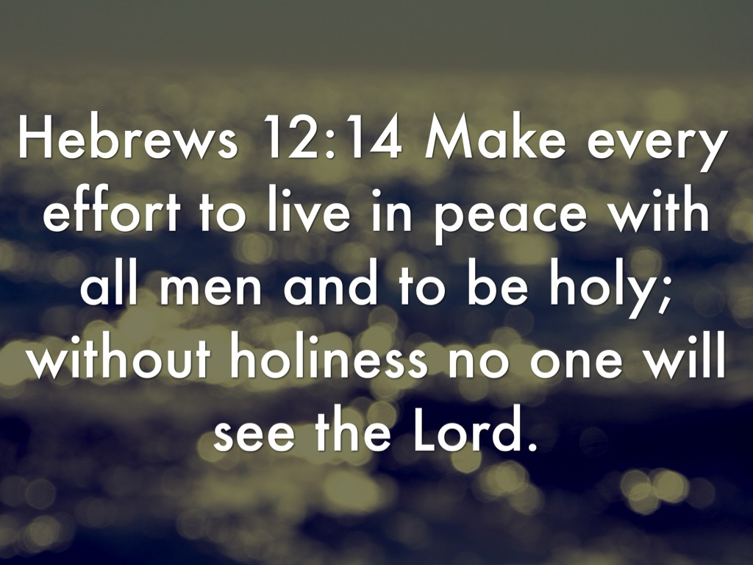

Slide 9
1 Corinthians 9:27
But I discipline my body and bring it into subjection, lest, when I have preached to others, I myself should become disqualified

Slide 10
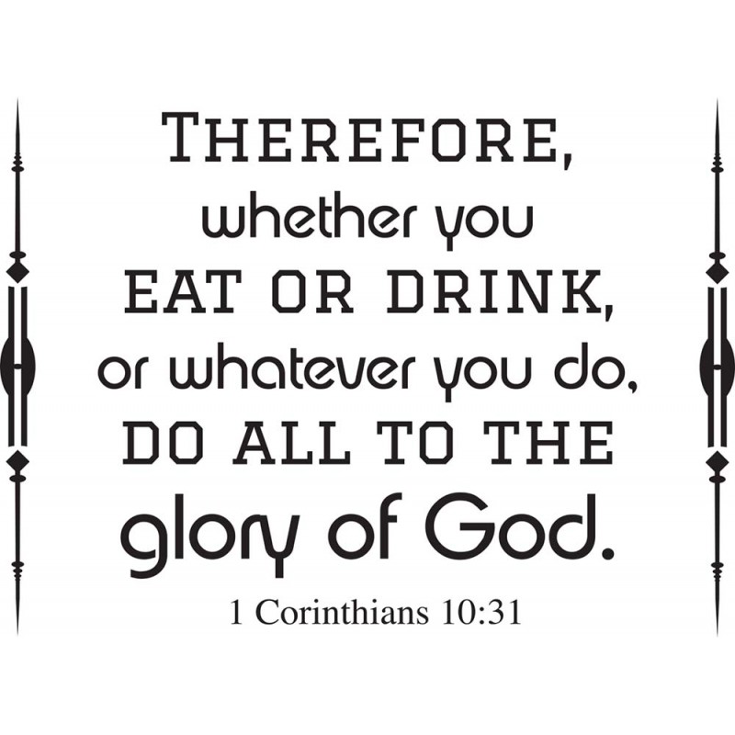

Slide 11
Ephesians 4:14-16 Then we will no longer be infants, tossed back and forth by the waves, and blown here and there by every wind of teaching and by the cunning and craftiness of people in their deceitful scheming. ¹⁵ Instead, speaking the truth in love, we will grow to become in every respect the mature body of him who is the head, that is, Christ. ¹⁶ From him the whole body, joined and held together by every supporting ligament, grows and builds itself up in love, as each part does its work.

Slide 12
2 Peter 3:17-18
Therefore, dear friends, since you have been forewarned, be on your guard so that you may not be carried away by the error of the lawless and fall from your secure position. ¹⁸ But grow in the grace and knowledge of our Lord and Savior Jesus Christ. To him be glory both now and forever! Amen.

Slide 13
Luke 9:23-24 Then he said to them all: “Whoever wants to be my disciple must deny themselves and take up their cross daily and follow me. ²⁴ For whoever wants to save their life will lose it, but whoever loses their life for me will save it.

Slide 14
He must become greater; I must become less.” John 3:30
.

Slide 15
Philippians 2:6-9
Who, being in very nature God did not consider equality with God something to be used to his own advantage; ⁷ rather, he made himself nothing by taking the very nature of a servant, being made in human likeness.⁸ And being found in appearance as a man, he humbled himself by becoming obedient to death— even death on a cross! ⁹ Therefore God exalted him to the highest place and gave him the name that is above every name,

Slide 16
Romans 13:12 The night is nearly over; the day is almost here. So let us put aside the deeds of darkness and put on the armor of light.
The night is almost gone; the day of salvation will soon be here. So remove your dark deeds like dirty clothes, and put on the shining armor of right living. Romans 13:12 (NLT)

Slide 17
Matthew 18:7-9 Woe to the world because of the things that cause people to stumble! Such things must come, but woe to the person through whom they come! ⁸ If your hand or your foot causes you to stumble, cut it off and throw it away. It is better for you to enter life maimed or crippled than to have two hands or two feet and be thrown into eternal fire. ⁹ And if your eye causes you to stumble, gouge it out and throw it away. It is better for you to enter life with one eye than to have two eyes and be thrown into the fire of hell.

