Slide 2
“How To Reveal The Savior”

Slide 3
Hebrews 4:12 For the word of God is alive and active. Sharper than any double-edged sword, it penetrates even to dividing soul and spirit, joints and marrow; it judges the thoughts and attitudes of the heart.

Slide 4
Colossians 2:8-9 See to it that no one takes you captive through hollow and deceptive philosophy, which depends on human tradition and the elemental spiritual forces of this world rather than on Christ.⁹ But now that you know God—or rather are known by God—how is it that you are turning back to those weak and miserable forces? Do you wish to be enslaved by them all over again?
John 6:14-15

Slide 5
Romans 8:38-39 For I am convinced that neither death nor life, neither angels nor demons, neither the present nor the future, nor any powers,³⁹ neither height nor depth, nor anything else in all creation, will be able to separate us from the love of God that is in Christ Jesus our Lord.

Slide 6
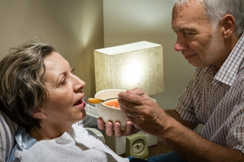
Ephesians 5:25-27 Husbands, love your wives, just as Christ loved the church and gave himself up for her ²⁶ to make her holy, cleansing her by the washing with water through the word, ²⁷ and to present her to himself as a radiant church, without stain or wrinkle or any other blemish, but holy and blameless.

Slide 7
John 15:1-16 “I am the true vine, and my Father is the gardener. ² He cuts off every branch in me that bears no fruit, while every branch that does bear fruit he prunes so that it will be even more fruitful. ³ You are already clean because of the word I have spoken to you. ⁴ Remain in me, as I also remain in you. No branch can bear fruit by itself; it must remain in the vine. Neither can you bear fruit unless you remain in me. ⁵ “I am the vine; you are the branches. If you remain in me and I in you, you will bear much fruit; apart from me you can do nothing. ⁶ If you do not remain in me, you are like a branch that is thrown away and withers; such branches are picked up, thrown into the fire and burned.

Slide 8
Acts 6:7 So the word of God spread. The number of disciples in Jerusalem increased rapidly, and a large number of priests became obedient to the faith.
Acts 12:24 But the word of God continued to spread and flourish.
Acts 16:5 So the churches were strengthened in the faith and grew daily in number
Acts 19:20 In this way the word of the Lord spread widely and grew in power.
⁷ If you remain in me and my words remain in you, ask whatever you wish, and it will be done for you. ⁸ This is to my Father’s glory, that you bear much fruit, showing yourselves to be my disciples. ⁹ “As the Father has loved me, so have I loved you. Now remain in my love. ¹⁰ If you keep my commands, you will remain in my love, just as I have kept my Father’s commands and remain in his love. ¹¹ I have told you this so that my joy may be in you and that your joy may be complete. ¹² My command is this: Love each other as I have loved you.
Exodus 3:14

Slide 9
¹³ Greater love has no one than this: to lay down one’s life for one’s friends. ¹⁴ You are my friends if you do what I command. ¹⁵ I no longer call you servants, because a servant does not know his master’s business. Instead, I have called you friends, for everything that I learned from my Father I have made known to you. ¹⁶ You did not choose me, but I chose you and appointed you so that you might go and bear fruit—fruit that will last—and so that whatever you ask in my name the Father will give you. ¹⁷ This is my command: Love each other.

Slide 10
John 17:18-23 As you sent me into the world, I have sent them into the world. ¹⁹ For them I sanctify myself, that they too may be truly sanctified. ²⁰ “My prayer is not for them alone. I pray also for those who will believe in me through their message, ²¹ that all of them may be one, Father, just as you are in me and I am in you. May they also be in us so that the world may believe that you have sent me. ²² I have given them the glory that you gave me, that they may be one as we are one— ²³ I in them and you in me—so that they may be brought to complete unity. Then the world will know that you sent me and have loved them even as you have loved me.

Slide 11
John 13:35 By this everyone will know that you are my disciples, if you love one another.”

Slide 12
Only let your manner of life be worthy of the gospel of Christ, so that whether I come and see you or am absent, I may hear of you that you are standing firm in one spirit, with one mind striving side by side for the faith of the gospel, ²⁸ and not frightened in anything by your opponents. This is a clear sign to them of their destruction, but of your salvation, and that from God. ²⁹ For it has been granted to you that for the sake of Christ you should not only believe in him but also suffer for his sake,
Philippians 1:27-29

Slide 13
1 Peter 2:4-5 As you come to him, a living stone rejected by men but in the sight of God chosen and precious, ⁵ you yourselves like living stones are being built up as a spiritual house, to be a holy priesthood, to offer spiritual sacrifices acceptable to God through Jesus Christ.

Slide 14
1 Corinthians 3:16
Do you not know that you are God's temple and that God's Spirit dwells in you?

Slide 15
For through him we both have access to the Father by one Spirit.¹⁹ Consequently, you are no longer foreigners and strangers, but fellow citizens with God’s people and also members of his household, ²⁰ built on the foundation of the apostles and prophets, with Christ Jesus himself as the chief cornerstone.²¹ In him the whole building is joined together and rises to become a holy temple in the Lord. ²² And in him you too are being built together to become a dwelling in which God lives by his Spirit. Ephesians 2:18-22
Matthew 11:29-30

Slide 16
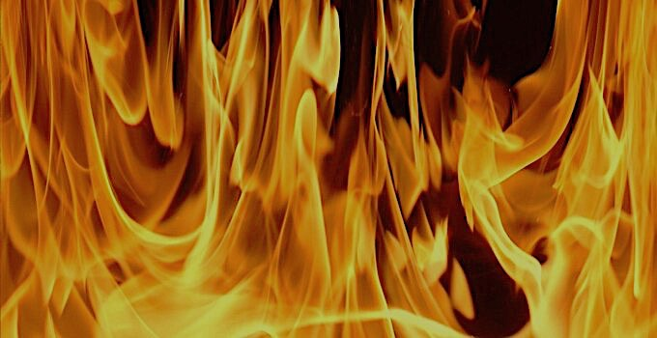
When Solomon finished praying, fire came down from heaven and consumed the burnt offering and the sacrifices, and the glory of the Lord filled the temple. ² The priests could not enter the temple of the Lord because the glory of the Lord filled it. ³ When all the Israelites saw the fire coming down and the glory of the Lord above the temple, they knelt on the pavement with their faces to the ground, and they worshiped and gave thanks to the Lord, saying, “He is good; his love endures forever.” 2 Chronicles 7:1-3

Slide 17
Acts 2: 1-3 When the day of Pentecost came, they were all together in one place. ² Suddenly a sound like the blowing of a violent wind came from heaven and filled the whole house where they were sitting. ³ They saw what seemed to be tongues of fire that separated and came to rest on each of them. ⁴ All of them were filled with the Holy Spirit and began to speak in other tongues as the Spirit enabled them.

Slide 18
Acts 2:37-41 When the people heard this, they were cut to the heart and said to Peter and the other apostles, “Brothers, what shall we do?”³⁸ Peter replied, “Repent and be baptized, every one of you, in the name of Jesus Christ for the forgiveness of your sins. And you will receive the gift of the Holy Spirit. ³⁹ The promise is for you and your children and for all who are far off—for all whom the Lord our God will call.”⁴⁰ With many other words he warned them; and he pleaded with them, “Save yourselves from this corrupt generation.” ⁴¹ Those who accepted his message were baptized, and about three thousand were added to their number that day.

