Slide 2
“Empty Grave
Full Life”

Slide 3
But if it is preached that Christ has been raised from the dead, how can some of you say that there is no resurrection of the dead? ¹³ If there is no resurrection of the dead, then not even Christ has been raised.¹⁴ And if Christ has not been raised, our preaching is useless and so is your faith. ¹⁵ More than that, we are then found to be false witnesses about God, for we have testified about God that he raised Christ from the dead. But he did not raise him if in fact the dead are not raised. ¹⁶ For if the dead are not raised, then Christ has not been raised either. ¹⁷ And if Christ has not been raised, your faith is futile; you are still in your sins.¹⁸ Then those also who have fallen asleep in Christ are lost. ¹⁹ If only for this life we have hope in Christ, we are of all people most to be pitied. ²⁰ But Christ has indeed been raised from the dead, the first fruits of those who have fallen asleep.
1 Corinthians 15:12-20

Slide 4
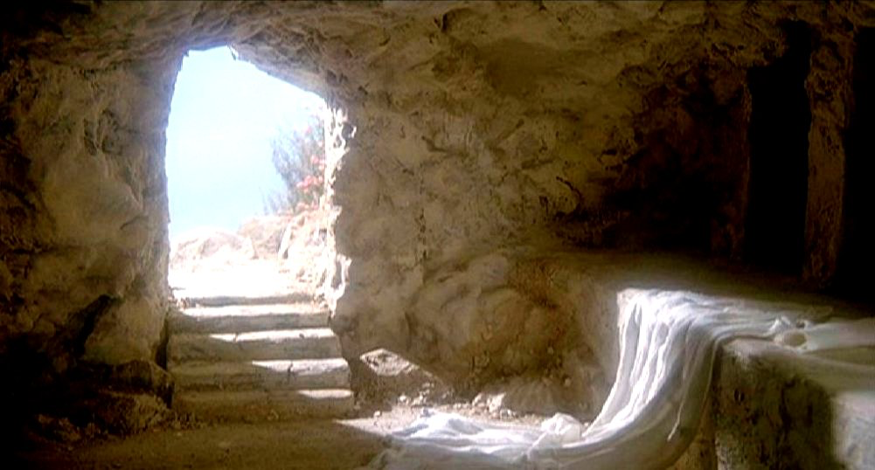
1Corinthians 15:14
And if Christ has not been raised, our preaching is useless and so is your faith.

Slide 5
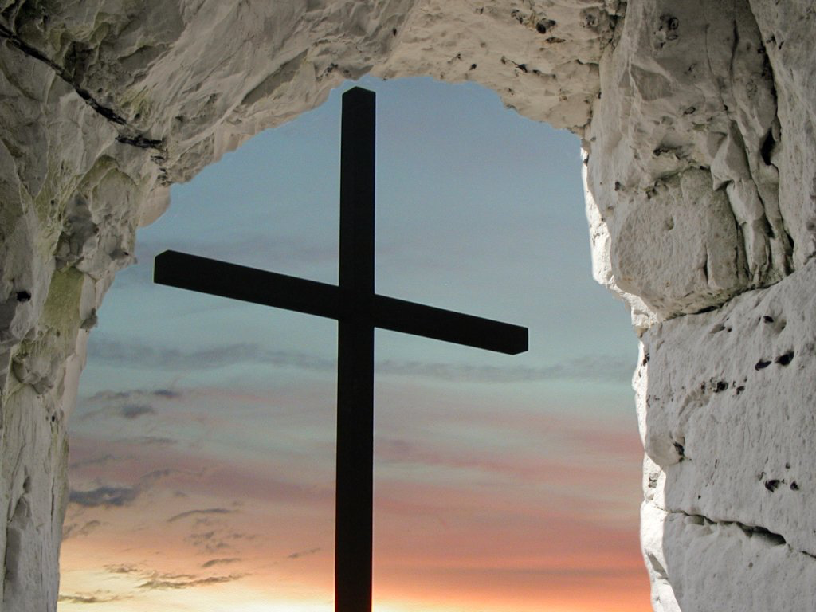
Galatians 2:20
I have been crucified with Christ. It is no longer I who live, but Christ who lives in me. And the life I now live in the flesh I live by faith in the Son of God, who loved me and gave himself for me.

Slide 6
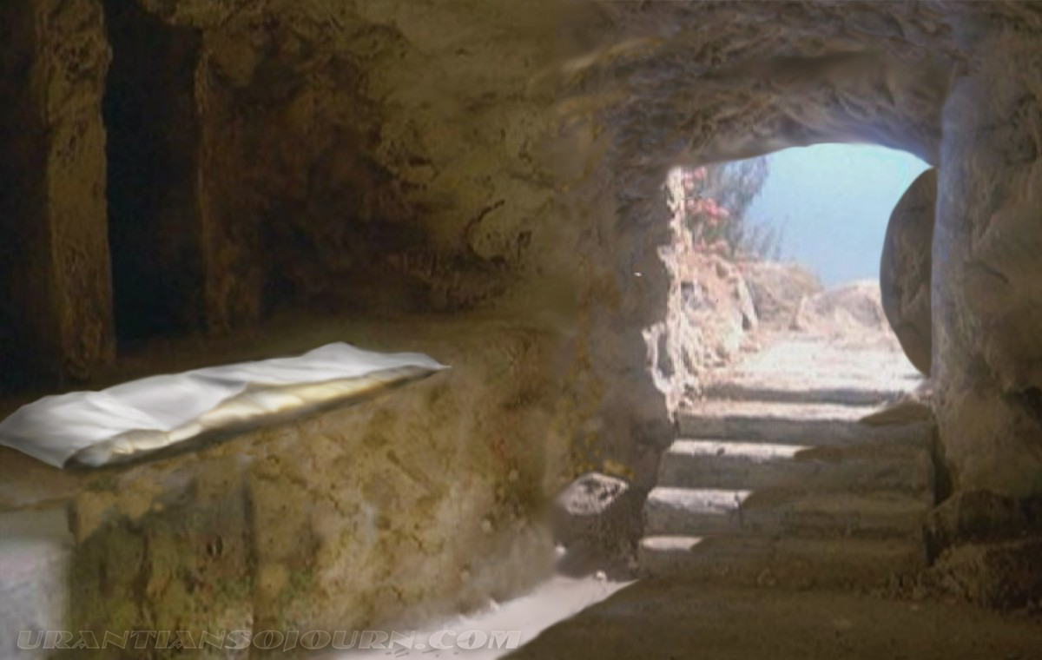
More than that, we are then found to be false witnesses about God, for we have testified about God that he raised Christ from the dead. But he did not raise him if in fact the dead are not raised.
^{1Corinthians 15:15}

Slide 7
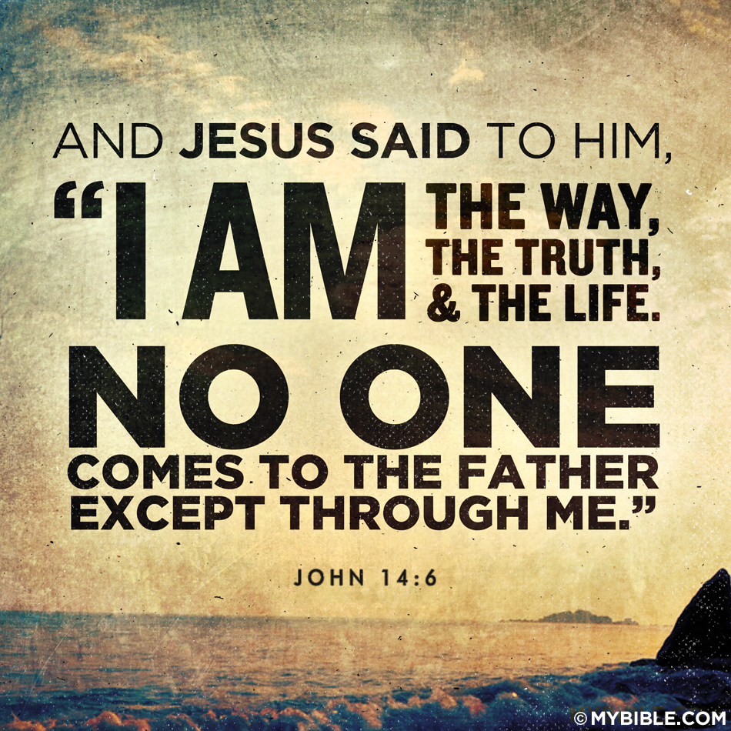
Acts 6:7 So the word of God spread. The number of disciples in Jerusalem increased rapidly, and a large number of priests became obedient to the faith.
Acts 12:24 But the word of God continued to spread and flourish.
Acts 16:5 So the churches were strengthened in the faith and grew daily in number
Acts 19:20 In this way the word of the Lord spread widely and grew in power.
Exodus 3:14

Slide 8
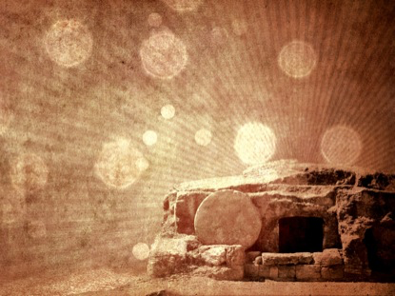
1Corinthians 15:17
And if Christ has not been raised, your faith is futile; you are still in your sins.

Slide 9
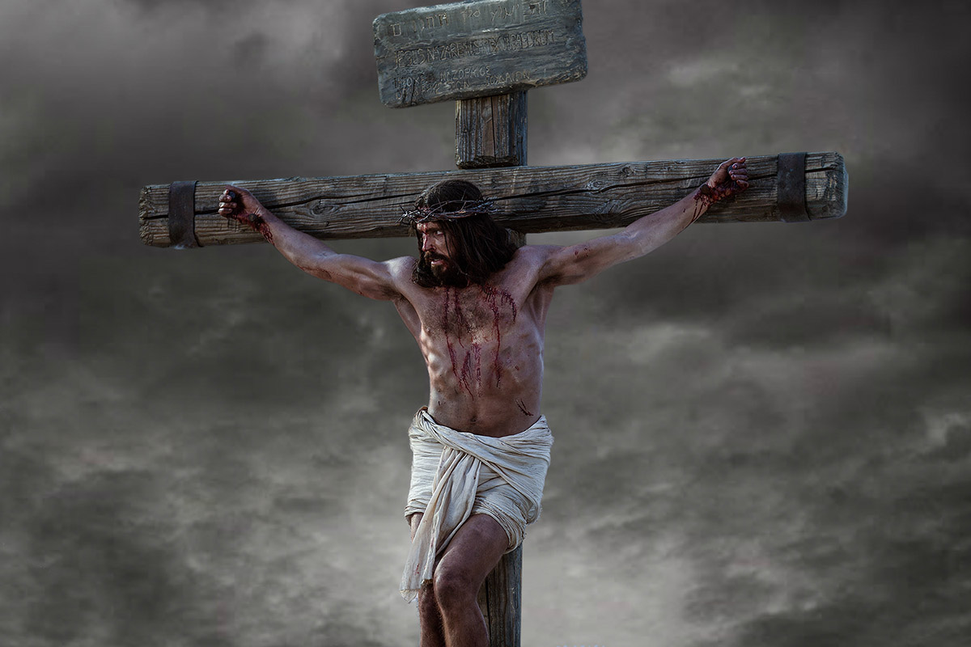
1 Corinthians 15:3
For I delivered to you first of all that which I also received: that Christ died for our sins according to the Scriptures,

Slide 10
He was delivered over to death for our sins and was raised to life for our justification
Romans 4:25

Slide 11
1Corinthians 15:18 (If there is no resurrection)
Then those also who have fallen asleep in Christ are lost.

Slide 12
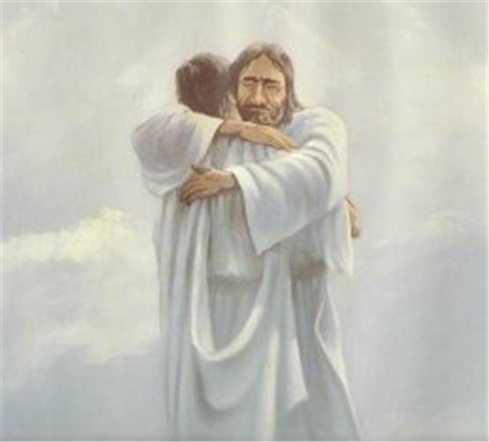
Matthew 25:21
His master said to him, ‘Well done, good and faithful servant. You have been faithful over a little; I will set you over much. Enter into the joy of your master.’

Slide 13
1Corinthians 15:19 ^{(If there is no resurrection)}
If only for this life we have hope in Christ, we are of all people most to be pitied.
2 Corinthians 4:17 For our light and momentary troubles are achieving for us an eternal glory that far outweighs them all.

Slide 14
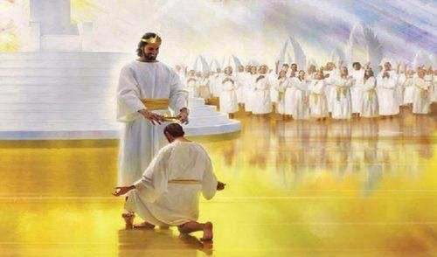
1 Corinthians 15:58 Therefore, my dear brothers and sisters, stand firm. Let nothing move you. Always give yourselves fully to the work of the Lord, because you know that your labor in the Lord is not in vain.
Matthew 11:29-30

Slide 16
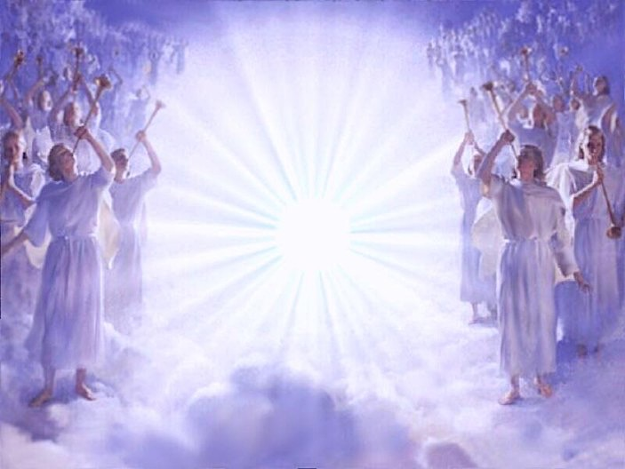
Revelation 5:11-13 Then I looked and heard the voice of many angels, numbering thousands upon thousands, and ten thousand times ten thousand. They encircled the throne and the living creatures and the elders. ¹² In a loud voice they were saying: “Worthy is the Lamb, who was slain, to receive power and wealth and wisdom and strength and honor and glory and praise!” ¹³ Then I heard every creature in heaven and on earth and under the earth and on the sea, and all that is in them, saying: “To him who sits on the throne and to the Lamb be praise and honor and glory and power, for ever and ever!”

