Slide 2
Hebrews 4:12 For the word of God is alive and active. Sharper than any double-edged sword, it penetrates even to dividing soul and spirit, joints and marrow; it judges the thoughts and attitudes of the heart.

Slide 3
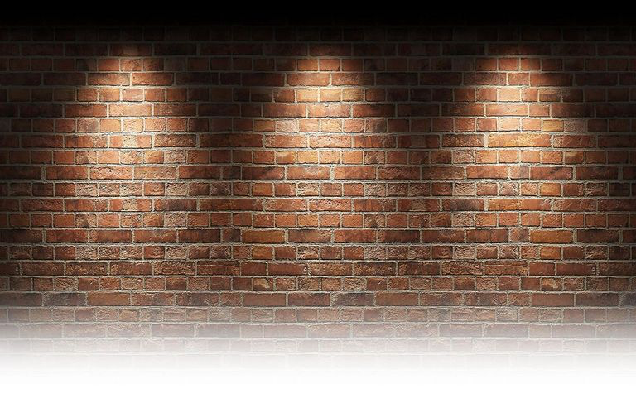
“FAITH WALKING”

Slide 4
Romans 8:5-8(NIV)
Those who live according to the flesh have their minds set on what the flesh desires; but those who live in accordance with the Spirit have their minds set on what the Spirit desires. ⁶ The mind governed by the flesh is death, but the mind governed by the Spirit is life and peace. ⁷ The mind governed by the flesh is hostile to God; it does not submit to God’s law, nor can it do so. ⁸ Those who are in the realm of the flesh cannot please God.

Slide 5
2 Timothy 3:1-5 (NIV)
But mark this: There will be terrible times in the last days. ² People will be lovers of themselves, lovers of money, boastful, proud, abusive, disobedient to their parents, ungrateful, unholy, ³ without love, unforgiving, slanderous, without self-control, brutal, not lovers of the good, ⁴ treacherous, rash, conceited, lovers of pleasure rather than lovers of God— ⁵ having a form of godliness but denying its power. Have nothing to do with such people.

Slide 6
Hebrews 11:1-2(NIV)
Now faith is confidence in what we hope for and assurance about what we do not see. ² This is what the ancients were commended for.
NKJV - ¹Now faith is the substance of things hoped for, the evidence of things not seen. ² For by it the elders obtained a good testimony.

Slide 9
James 2:14-26(NIV)
What good is it, my brothers and sisters, if someone claims to have faith but has no deeds? Can such faith save them? ¹⁵ Suppose a brother or a sister is without clothes and daily food. ¹⁶ If one of you says to them, “Go in peace; keep warm and well fed,” but does nothing about their physical needs, what good is it?¹⁷ In the same way, faith by itself, if it is not accompanied by action, is dead.

Slide 10
¹⁸ But someone will say, “You have faith; I have deeds.”Show me your faith without deeds, and I will show you my faith by my deeds. ¹⁹ You believe that there is one God. Good! Even the demons believe that—and shudder.²⁰ You foolish person, do you want evidence that faith without deeds is useless? ²¹ Was not our father Abraham considered righteous for what he did when he offered his son Isaac on the altar? ²² You see that his faith and his actions were working together, and his faith was made complete by what he did.

Slide 11
²³ And the scripture was fulfilled that says, “Abraham believed God, and it was credited to him as righteousness,” and he was called God’s friend. ²⁴ You see that a person is considered righteous by what they do and not by faith alone. ²⁵ In the same way, was not even Rahab the prostitute considered righteous for what she did when she gave lodging to the spies and sent them off in a different direction? ²⁶ As the body without the spirit is dead, so faith without deeds is dead.

Slide 12
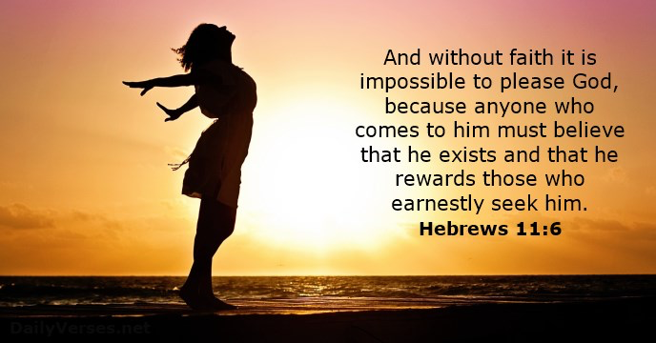
Exodus 3:14

Slide 14
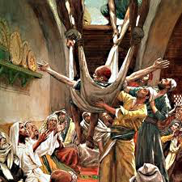
Luke 5:19-20(NIV) When they could not find a way to do this because of the crowd, they went up on the roof and lowered him on his mat through the tiles into the middle of the crowd, right in front of Jesus.²⁰ When Jesus saw their faith, he said, “Friend, your sins are forgiven.”

Slide 15
Habakkuk 2:4 (ESV) “Behold, his soul is puffed up; it is not upright within him, but the righteous shall live by his faith
Romans 1:1(NKJV) For in it the righteousness of God is revealed from faith to faith; as it is written, “The just shall live by faith.”
Galatians 3:11 (ESV) Now it is evident that no one is justified before God by the law, for “The righteous shall live by faith.”

Slide 16
Hebrews 10:38 (NIV)
“But my righteous one will live by faith. And I take no pleasure in the one who shrinks back.”

Slide 17
In Hebrews 11 By Faith – Abel brought God a better offering By Faith – Enoch was taken by God By Faith – Built an Ark By Faith - Abraham left in pursuit of the promised land inheritance,
(For he was looking forward to the city with foundations, whose architect and builder is God.)
By Faith – Sarah was enabled to bear children
By Faith – Abraham offered Isaac By Faith - Moses’ parents hid him By Faith – Moses Left Egypt, kept Passover, passed through the Sea. By Faith – Jacob marched around Jericho and the walls fell. By Faith – Rahab welcomed spies and was spared.

Slide 18
Gideon, Barak, Samson and Jephthah, about David and Samuel and the prophets, ³³ who through faith conquered kingdoms, administered justice, and gained what was promised; who shut the mouths of lions, ³⁴ quenched the fury of the flames, ³⁵ Women received back their dead, raised to life again. There were others who were tortured, refusing to be released so that they might gain an even better resurrection. ³⁶ Some faced jeers and flogging, and even chains and imprisonment. ³⁷ They were put to death by stoning; they were sawed in two; they were killed by the sword.

Slide 19
Psalm 143:10 Teach me to do your will, for you are my God; may your good Spirit lead me on level ground
Hebrews 12(NIV) Therefore, since we are surrounded by such a great cloud of witnesses, let us throw off everything that hinders and the sin that so easily entangles. And let us run with perseverance the race marked out for us, ² fixing our eyes on Jesus, the pioneer and perfecter of faith. For the joy set before him he endured the cross, scorning its shame, and sat down at the right hand of the throne of God. ³ Consider him who endured such opposition from sinners, so that you will not grow weary and lose heart.

Slide 20
Luke 6:32-36 “If you love those who love you, what credit is that to you? Even sinners love those who love them. 33 And if you do good to those who are good to you, what credit is that to you? Even sinners do that. 34 And if you lend to those from whom you expect repayment, what credit is that to you? Even sinners lend to sinners, expecting to be repaid in full. 35 But love your enemies, do good to them, and lend to them without expecting to get anything back. Then your reward will be great, and you will be children of the Most High, because he is kind to the ungrateful and wicked. 36 Be merciful, just as your Father is merciful.

