Slide 2
Hebrews 4:12 For the word of God is alive and active. Sharper than any double-edged sword, it penetrates even to dividing soul and spirit, joints and marrow; it judges the thoughts and attitudes of the heart.

Slide 3
“It’s Not a Collectors' Item”

Slide 4
Psalm 16:1-11 Keep me safe, my God, for in you I take refuge.
² I say to the Lord, “You are my Lord; apart from you I have no good thing.” ³ I say of the holy people who are in the land, “They are the noble ones in whom is all my delight.” ⁴ Those who run after other gods will suffer more and more. I will not pour out libations of blood to such gods or take up their names on my lips. ⁵ Lord, you alone are my portion and my cup; you make my lot secure. ⁶ The boundary lines have fallen for me in pleasant places; surely I have a delightful inheritance. ⁷ I will praise the Lord, who counsels me; even at night my heart instructs me.⁸ I keep my eyes always on the Lord. With him at my right hand, I will not be shaken.⁹ Therefore my heart is glad and my tongue rejoices; my body also will rest secure,¹⁰ because you will not abandon me to the realm of the dead, nor will you let your faithful one see decay. ¹¹ You make known to me the path of life; you will fill me with joy in your presence, with eternal pleasures at your right hand.

Slide 5
Psalm 16:1-11 Keep me safe, my God, for in you I take refuge.² I say to the Lord, “You are my Lord; apart from you I have no good thing.” ³ I say of the holy people who are in the land, “They are the noble ones in whom is all my delight.” ⁴ Those who run after other gods will suffer more and more. I will not pour out libations of blood to such gods or take up their names on my lips. ⁵ Lord, you alone are my portion and my cup; you make my lot secure. ⁶ The boundary lines have fallen for me in pleasant places; surely I have a delightful inheritance. ⁷ I will praise the Lord, who counsels me; even at night my heart instructs me.⁸ I keep my eyes always on the Lord. With him at my right hand, I will not be shaken.⁹ Therefore my heart is glad and my tongue rejoices; my body also will rest secure,¹⁰ because you will not abandon me to the realm of the dead, nor will you let your faithful one see decay. ¹¹ You make known to me the path of life; you will fill me with joy in your presence, with eternal pleasures at your right hand.

Slide 6
Psalm 16:1-11 Keep me safe, my God, for in you I take refuge.
² I say to the Lord, “You are my Lord; apart from you I have no good thing.” ³ I say of the holy people who are in the land, “They are the noble ones in whom is all my delight.” ⁴ Those who run after other gods will suffer more and more. I will not pour out libations of blood to such gods or take up their names on my lips. ⁵ Lord, you alone are my portion and my cup; you make my lot secure. ⁶ The boundary lines have fallen for me in pleasant places; surely I have a delightful inheritance. ⁷ I will praise the Lord, who counsels me; even at night my heart instructs me.⁸ I keep my eyes always on the Lord. With him at my right hand, I will not be shaken.⁹ Therefore my heart is glad and my tongue rejoices; my body also will rest secure,¹⁰ because you will not abandon me to the realm of the dead, nor will you let your faithful one see decay. ¹¹ You make known to me the path of life; you will fill me with joy in your presence, with eternal pleasures at your right hand.

Slide 7
Psalm 16:1-11 Keep me safe, my God, for in you I take refuge.
² I say to the Lord, “You are my Lord; apart from you I have no good thing.” ³ I say of the holy people who are in the land, “They are the noble ones in whom is all my delight.” ⁴ Those who run after other gods will suffer more and more. I will not pour out libations of blood to such gods or take up their names on my lips. ⁵ Lord, you alone are my portion and my cup; you make my lot secure. ⁶ The boundary lines have fallen for me in pleasant places; surely I have a delightful inheritance. ⁷ I will praise the Lord, who counsels me; even at night my heart instructs me.⁸ I keep my eyes always on the Lord. With him at my right hand, I will not be shaken.⁹ Therefore my heart is glad and my tongue rejoices; my body also will rest secure,¹⁰ because you will not abandon me to the realm of the dead, nor will you let your faithful one see decay. ¹¹ You make known to me the path of life; you will fill me with joy in your presence, with eternal pleasures at your right hand.

Slide 8
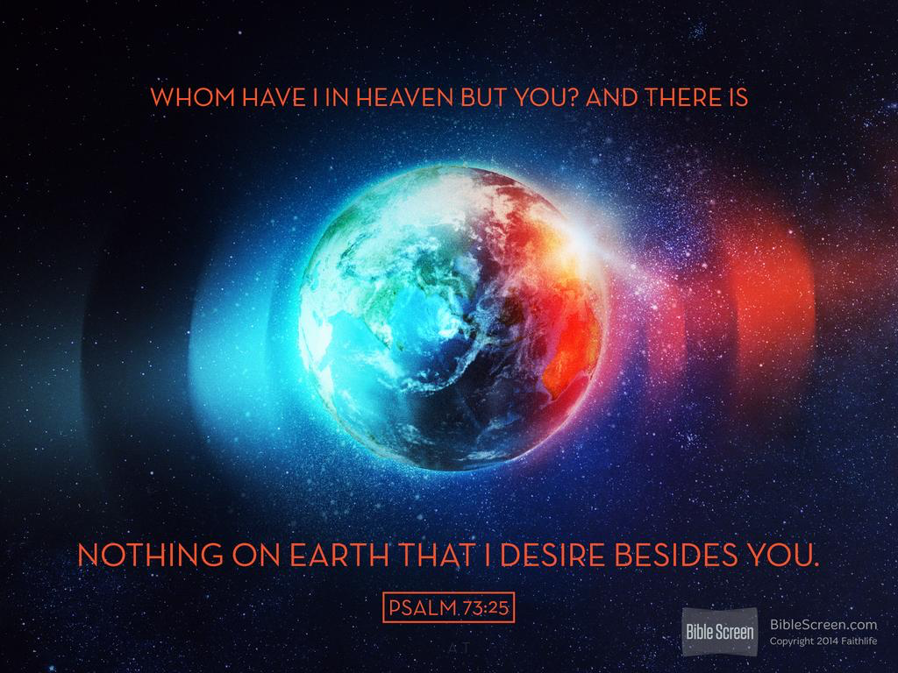

Slide 9
Psalm 16:1-11 Keep me safe, my God, for in you I take refuge.
² I say to the Lord, “You are my Lord; apart from you I have no good thing.” ³ I say of the holy people who are in the land, “They are the noble ones in whom is all my delight.” ⁴ Those who run after other gods will suffer more and more. I will not pour out libations of blood to such gods or take up their names on my lips. ⁵ Lord, you alone are my portion and my cup; you make my lot secure. ⁶ The boundary lines have fallen for me in pleasant places; surely I have a delightful inheritance. ⁷ I will praise the Lord, who counsels me; even at night my heart instructs me.⁸ I keep my eyes always on the Lord. With him at my right hand, I will not be shaken.⁹ Therefore my heart is glad and my tongue rejoices; my body also will rest secure,¹⁰ because you will not abandon me to the realm of the dead, nor will you let your faithful one see decay. ¹¹ You make known to me the path of life; you will fill me with joy in your presence, with eternal pleasures at your right hand.

Slide 10
To the godly the Lord offers a cup of blessing or salvation:
Psalm 23:5 You prepare a table before me in the presence of my enemies. You anoint my head with oil; my cup overflows.
Psalm 116:13 I will lift up the cup of salvation and call on the name of the Lord.
The wicked drink from a cup of wrath
Jeremiah 25:15 This is what the Lord, the God of Israel, said to me: “Take from my hand this cup filled with the wine of my wrath and make all the nations to whom I send you drink

Slide 11
Psalm 16:1-11 Keep me safe, my God, for in you I take refuge.
² I say to the Lord, “You are my Lord; apart from you I have no good thing.” ³ I say of the holy people who are in the land, “They are the noble ones in whom is all my delight.” ⁴ Those who run after other gods will suffer more and more. I will not pour out libations of blood to such gods or take up their names on my lips. ⁵ Lord, you alone are my portion and my cup; you make my lot secure. ⁶ The boundary lines have fallen for me in pleasant places; surely I have a delightful inheritance. ⁷ I will praise the Lord, who counsels me; even at night my heart instructs me.⁸ I keep my eyes always on the Lord. With him at my right hand, I will not be shaken.⁹ Therefore my heart is glad and my tongue rejoices; my body also will rest secure,¹⁰ because you will not abandon me to the realm of the dead, nor will you let your faithful one see decay. ¹¹ You make known to me the path of life; you will fill me with joy in your presence, with eternal pleasures at your right hand.

Slide 12
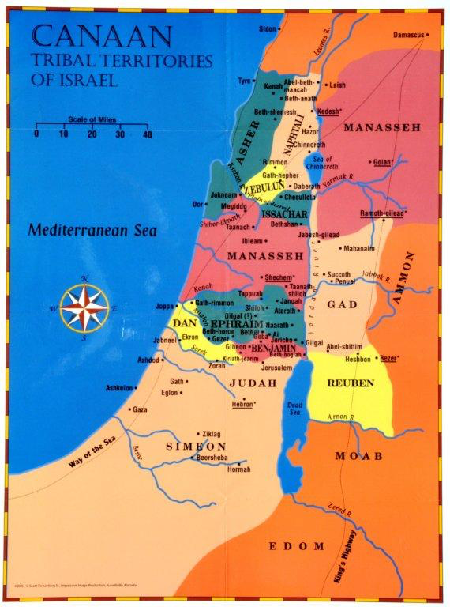
Joshua 21:43-45 So the Lord gave Israel all the land he had sworn to give their ancestors, and they took possession of it and settled there. ⁴⁴ The Lord gave them rest on every side, just as he had sworn to their ancestors. Not one of their enemies withstood them; the Lord gave all their enemies into their hands. ⁴⁵ Not one of all the Lord’s good promises to Israel failed; every one was fulfilled.
Exodus 3:14

Slide 13
Psalm 16:1-11 Keep me safe, my God, for in you I take refuge.
² I say to the Lord, “You are my Lord; apart from you I have no good thing.” ³ I say of the holy people who are in the land, “They are the noble ones in whom is all my delight.” ⁴ Those who run after other gods will suffer more and more. I will not pour out libations of blood to such gods or take up their names on my lips. ⁵ Lord, you alone are my portion and my cup; you make my lot secure. ⁶ The boundary lines have fallen for me in pleasant places; surely I have a delightful inheritance. ⁷ I will praise the Lord, who counsels me; even at night my heart instructs me.⁸ I keep my eyes always on the Lord. With him at my right hand, I will not be shaken.⁹ Therefore my heart is glad and my tongue rejoices; my body also will rest secure,¹⁰ because you will not abandon me to the realm of the dead, nor will you let your faithful one see decay. ¹¹ You make known to me the path of life; you will fill me with joy in your presence, with eternal pleasures at your right hand.

Slide 14
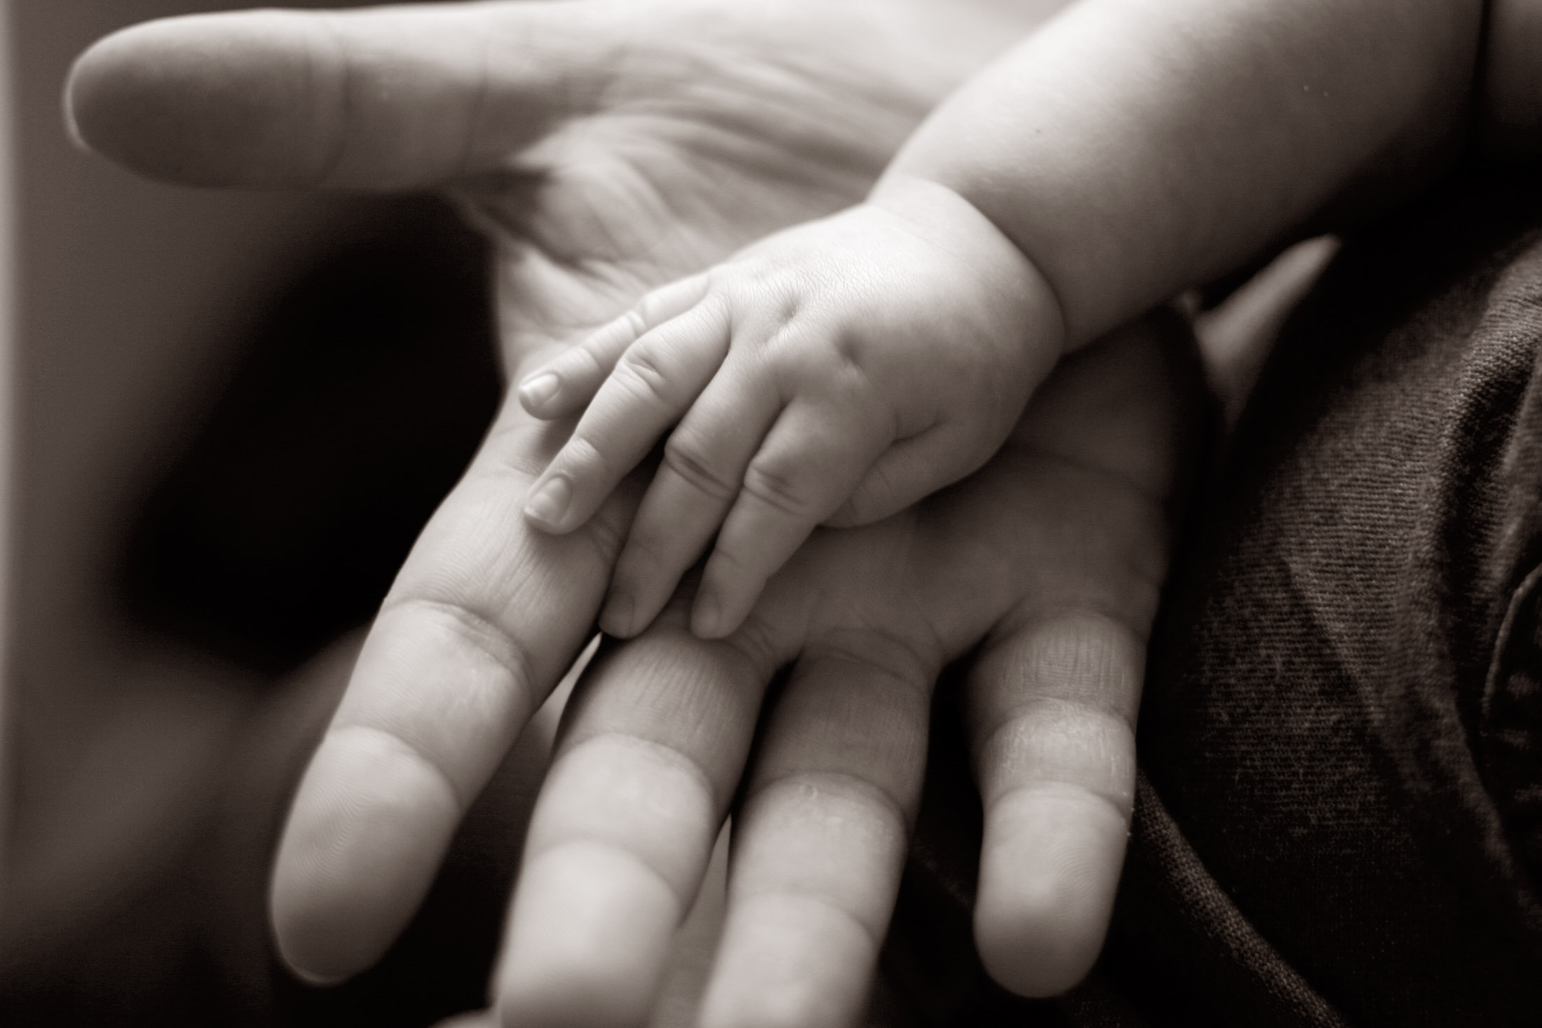
Psalm 73:23 Yet I am always with you; you hold me by my right hand.

Slide 15
Psalm 16:1-11 Keep me safe, my God, for in you I take refuge.
² I say to the Lord, “You are my Lord; apart from you I have no good thing.” ³ I say of the holy people who are in the land, “They are the noble ones in whom is all my delight.” ⁴ Those who run after other gods will suffer more and more. I will not pour out libations of blood to such gods or take up their names on my lips. ⁵ Lord, you alone are my portion and my cup; you make my lot secure. ⁶ The boundary lines have fallen for me in pleasant places; surely I have a delightful inheritance. ⁷ I will praise the Lord, who counsels me; even at night my heart instructs me.⁸ I keep my eyes always on the Lord. With him at my right hand, I will not be shaken.⁹ Therefore my heart is glad and my tongue rejoices; my body also will rest secure,¹⁰ because you will not abandon me to the realm of the dead, nor will you let your faithful one see decay. ¹¹ You make known to me the path of life; you will fill me with joy in your presence, with eternal pleasures at your right hand.

Slide 16
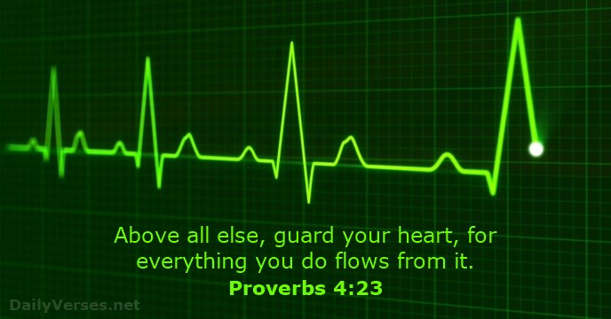

Slide 17
Psalm 16:1-11 Keep me safe, my God, for in you I take refuge.
² I say to the Lord, “You are my Lord; apart from you I have no good thing.” ³ I say of the holy people who are in the land, “They are the noble ones in whom is all my delight.” ⁴ Those who run after other gods will suffer more and more. I will not pour out libations of blood to such gods or take up their names on my lips. ⁵ Lord, you alone are my portion and my cup; you make my lot secure. ⁶ The boundary lines have fallen for me in pleasant places; surely I have a delightful inheritance. ⁷ I will praise the Lord, who counsels me; even at night my heart instructs me.⁸ I keep my eyes always on the Lord. With him at my right hand, I will not be shaken.⁹ Therefore my heart is glad and my tongue rejoices; my body also will rest secure,¹⁰ because you will not abandon me to the realm of the dead, nor will you let your faithful one see decay. ¹¹ You make known to me the path of life; you will fill me with joy in your presence, with eternal pleasures at your right hand.

Slide 18
Acts 2:25-28
David said about him: “‘I saw the Lord always before me. Because he is at my right hand, I will not be shaken. ²⁶ Therefore my heart is glad and my tongue rejoices; my body also will rest in hope, ²⁷ because you will not abandon me to the realm of the dead, you will not let your holy one see decay. ²⁸ You have made known to me the paths of life; you will fill me with joy in your presence.’

Slide 19
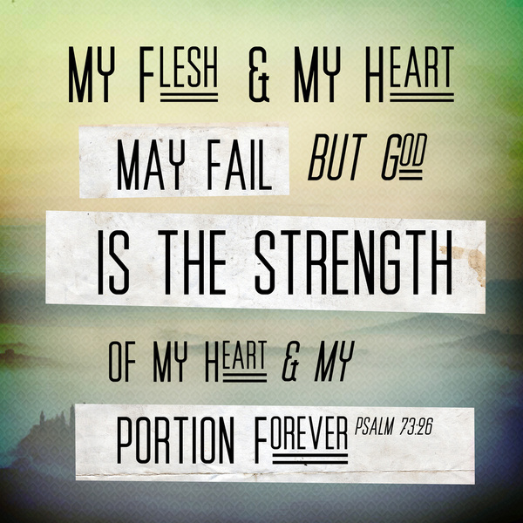
Psalm 143:10 Teach me to do your will, for you are my God; may your good Spirit lead me on level ground

Slide 20
Matthew 25:14-18
“Again, it will be like a man going on a journey, who called his servants and entrusted his wealth to them. ¹⁵ To one he gave five bags of gold, to another two bags, and to another one bag, each according to his ability. Then he went on his journey. ¹⁶ The man who had received five bags of gold went at once and put his money to work and gained five bags more^{. 17} So also, the one with two bags of gold gained two more. ¹⁸ But the man who had received one bag went off, dug a hole in the ground and hid his master’s money.
Luke 6:32-36 “If you love those who love you, what credit is that to you? Even sinners love those who love them. 33 And if you do good to those who are good to you, what credit is that to you? Even sinners do that. 34 And if you lend to those from whom you expect repayment, what credit is that to you? Even sinners lend to sinners, expecting to be repaid in full. 35 But love your enemies, do good to them, and lend to them without expecting to get anything back. Then your reward will be great, and you will be children of the Most High, because he is kind to the ungrateful and wicked. 36 Be merciful, just as your Father is merciful.

Slide 21
^{Matthew 25:19-23}
¹⁹ “After a long time the master of those servants returned and settled accounts with them. ²⁰ The man who had received five bags of gold brought the other five. ‘Master,’ he said, ‘you entrusted me with five bags of gold. See, I have gained five more.’ ²¹ “His master replied, ‘Well done, good and faithful servant! You have been faithful with a few things; I will put you in charge of many things. Come and share your master’s happiness!’ ²² “The man with two bags of gold also came. ‘Master,’ he said, ‘you entrusted me with two bags of gold; see, I have gained two more.’²³ “His master replied, ‘Well done, good and faithful servant! You have been faithful with a few things; I will put you in charge of many things. Come and share your master’s happiness!’

Slide 22
^{Matthew 25:24-28} “Then the man who had received one bag of gold came. ‘Master,’ he said, ‘I knew that you are a hard man, harvesting where you have not sown and gathering where you have not scattered seed. ²⁵ So I was afraid and went out and hid your gold in the ground. See, here is what belongs to you.’ ²⁶ “His master replied, ‘You wicked, lazy servant! So you knew that I harvest where I have not sown and gather where I have not scattered seed? ²⁷ Well then, you should have put my money on deposit with the bankers, so that when I returned I would have received it back with interest.
²⁸ “‘So take the bag of gold from him and give it to the one who has ten bags. ²⁹ For whoever has will be given more, and they will have an abundance. Whoever does not have, even what they have will be taken from them.

